Slide 1
ECLAT ALGORITHM

Slide 2
BASIC DEFINITIONS
Term | Definition
Apriori Algorithm | Apriori is an association rule mining algorithm used to find frequent itemsets in a transactional dataset and generate association rules based on minimum support and confidence thresholds.
Association Rule | An association rule is a relationship between items in a dataset that shows how the presence of one item affects the presence of another item. It is usually written as X → Y.
Itemset | An itemset is a group of one or more items that appear together in a transaction. Example: {Milk, Bread}
Frequent Itemset | A frequent itemset is a group of items that appear together in transactions more often than a specified minimum support threshold.
Support | Support measures how frequently an itemset appears in the dataset. It is the proportion of transactions that contain the itemset.
Confidence | Confidence measures the reliability of an association rule. It shows how often item Y appears in transactions that contain item X.
Lift | Lift measures the strength of an association rule by comparing the observed co-occurrence of items with their expected co-occurrence if they were independent.
Antecedent | The antecedent is the left-hand side of an association rule (the condition part). Example: In Milk → Bread, Milk is the antecedent.
Consequent | The consequent is the right-hand side of an association rule (the result part). Example: In Milk → Bread, Bread is the consequent.
Transaction | A transaction is a record containing a set of items purchased or occurring together. Example: {Milk, Bread, Butter}

Slide 3
ECLAT algorithm
ECLAT (Equivalence Class Clustering and bottom-up Lattice Traversal) is an algorithm used to find frequent itemsets in transactional datasets.
Principle: ECLAT works using a vertical data format.
Interchange of transaction ID and items.
Eclat uses a Depth-First Search (DFS) to explore item combination

Slide 4
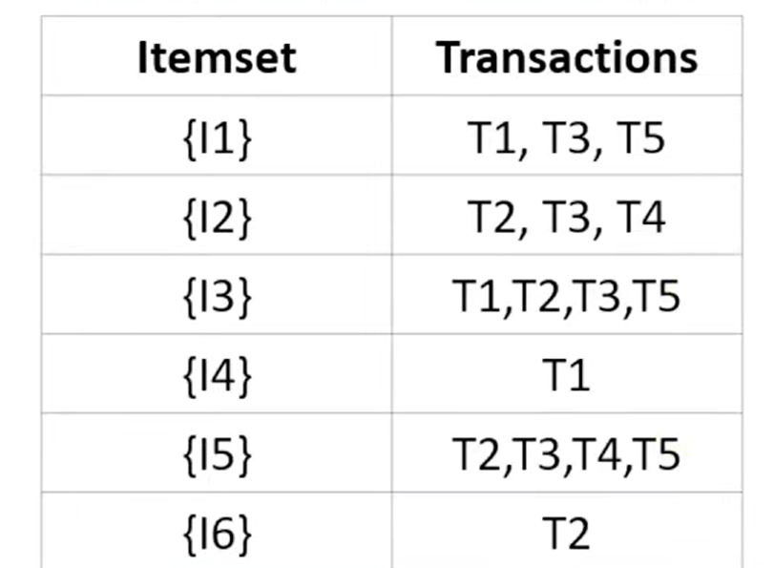
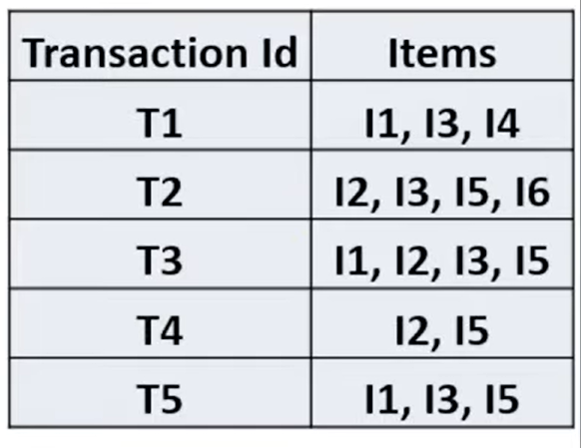
APRIORI
ECLAT

Slide 5
Steps of ECLAT Algorithm
Load transactional dataset
Convert dataset into vertical format (item → transaction IDs)
Apply minimum support threshold
Generate item combinations
Use set intersection to find common transactions
Calculate support of itemsets
Output frequent itemsets

Slide 6
Implementation steps followed
Load dataset using Pandas
Convert dataset to transaction format
Use pyECLAT library
Set minimum support
Generate frequent itemsets
Display results in DataFrame

